Slide 1
EcoLifestyle Agent
CAPSTONE PROJECT
Presented By:
KOTTI BHUVANA TEJA-Hyderabad Institute of Technology and Management-Computer science and Data Science

Slide 2
OUTLINE
Problem Statement (Should not include solution)
Proposed System/Solution
System Development Approach (Technology Used)
Algorithm & Deployment
Result (Output Image)
Conclusion
Future Scope
References

Slide 3
Problem Statement
Problem Statement No.6 – Eco Lifestyle Agent
The Challenge – An Eco Lifestyle Agent, powered by RAG (Retrieval-Augmented Generation), empowers users to adopt a greener lifestyle through personalized, practical suggestions. It retrieves sustainable living tips, eco-friendly product recommendations, local recycling guidelines, and government schemes from trusted environmental sources. Users can ask natural language questions such as “How can I reduce plastic use at home?” or “What are eco-friendly travel options in my city?” and receive instant, actionable guidance. The agent promotes small daily actions with big environmental impact, making sustainability easy and accessible. This AI-driven assistant fosters eco-conscious decisions, raises awareness, and helps build a more sustainable future. Technology – Use of IBM Cloud Lite services / IBM Granite is mandatory

Slide 4
🌱 The proposed system
The system aims to promote sustainable living through an AI-powered Eco Lifestyle Agent. It uses RAG (Retrieval-Augmented Generation) on IBM Cloud to provide personalized eco-friendly tips based on user preferences.
📥 Data Collection
Gather eco-related documents (e.g., sustainability tips, recycling rules, government schemes).
🧹 Data Preprocessing
Format content into question-answer pairs.
Clean and structure documents for better retrieval.
🧠 Machine Intelligence (RAG)
Use IBM Watsonx Agent with LLaMA model and RAG approach.
Agent retrieves relevant answers from uploaded documents using context.
🚀 Deployment
Build and deploy entirely on IBM Cloud Lite using watsonx.ai Agent Lab.Provide web-based interface through chat preview or embed.
📊 Evaluation
Test responses for relevance and accuracy.Improve by refining documents and prompt instructions.
✅ Result
Provides tailored suggestions like:
“How to reduce plastic at home?”
“What are eco-friendly travel options?”
“Government eco schemes in India?”

Slide 5
System Approach
The system approach section outlines the overall strategy and methodology for developing and deploying the Eco Lifestyle Agent using IBM Cloud and RAG.
✅ System Requirements
IBM Cloud Lite account.
Access to watsonx.ai Agent Lab.
RAG-capable foundation model (e.g., LLaMA 3).
Stable internet connection.
Word/PDF document with eco-knowledge base (for RAG).
📚 Libraries & Services Used
watsonx.ai Agent Lab (No-code)
LLaMA 3-70B-instruct (pre-loaded in IBM Agent Lab)
Built-in Google Search tool (optional for extended retrieval)
IBM Watsonx Discovery (alternative to file-based RAG)
File handling (Word/PDF upload)

Slide 6
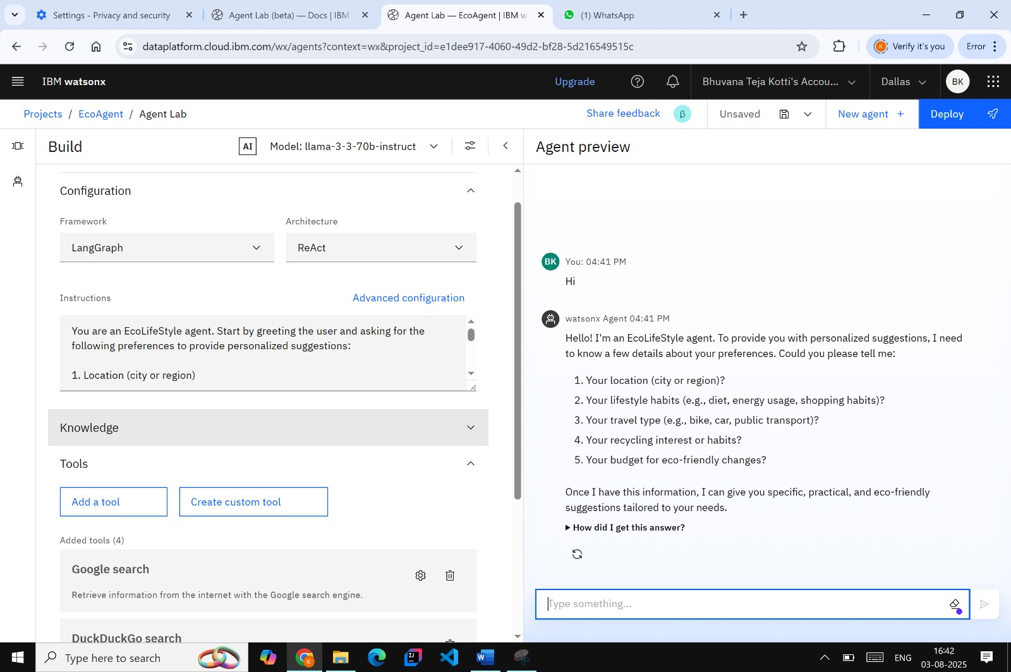
Result

Slide 7
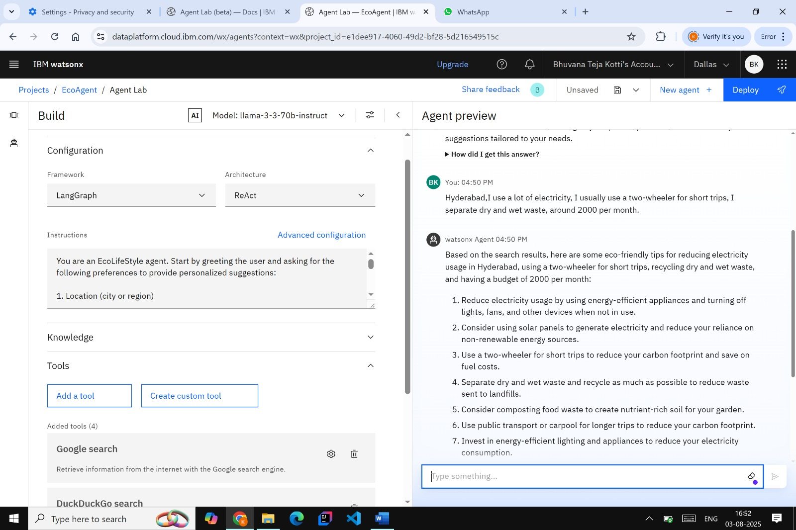

Result

Slide 8
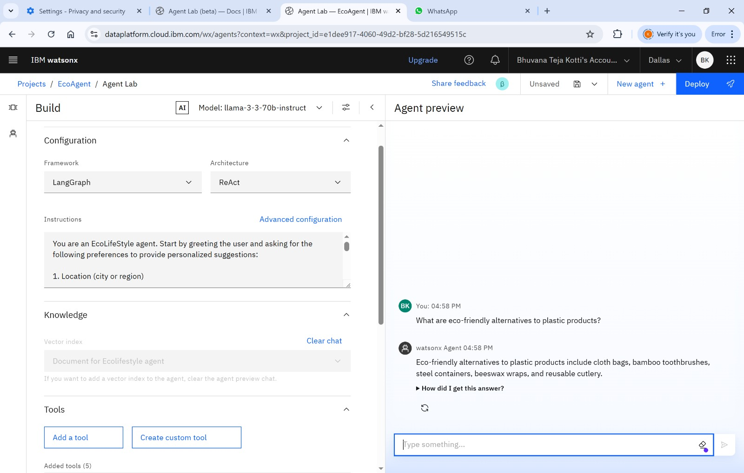
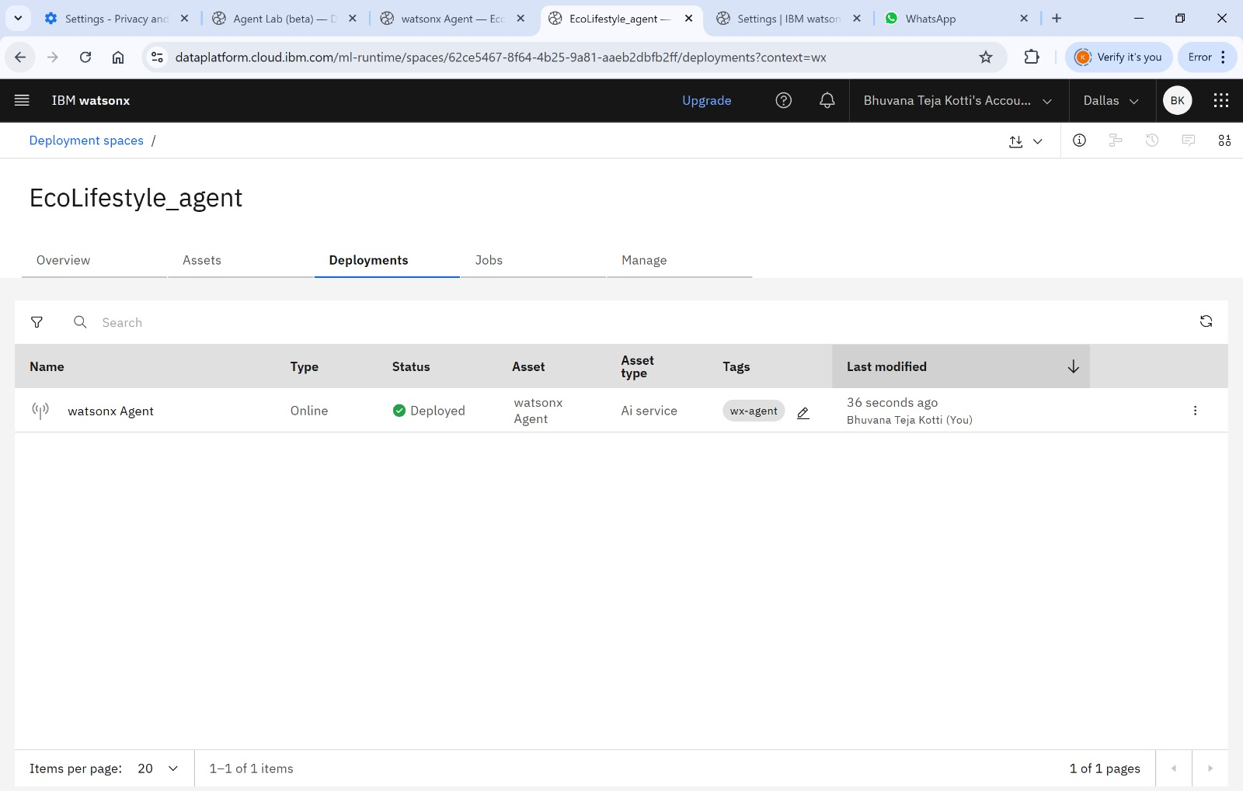
RESULT

Slide 9
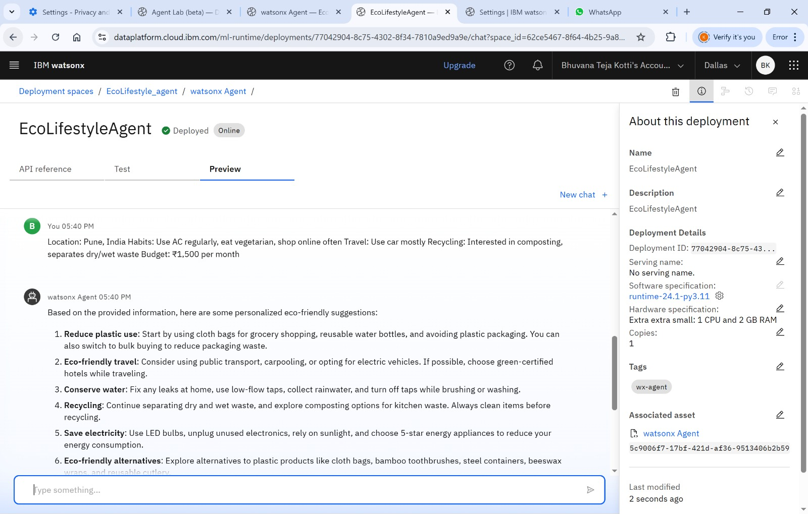
Result

Slide 10
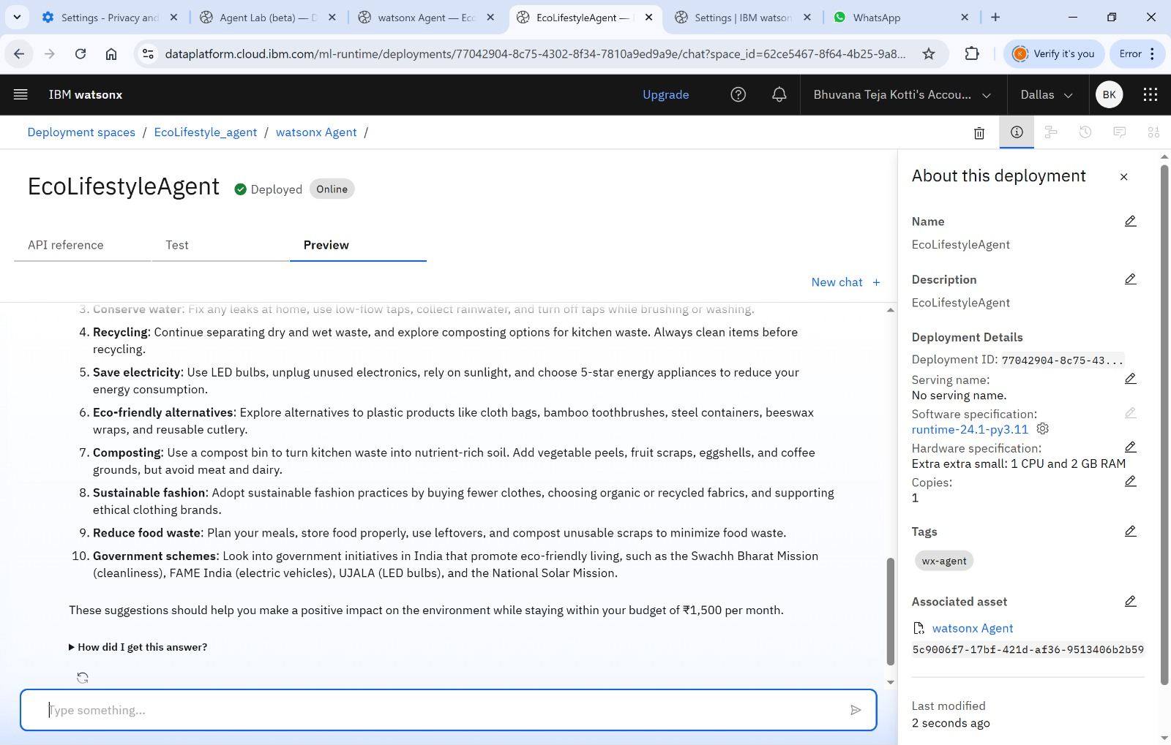
Result

Slide 11
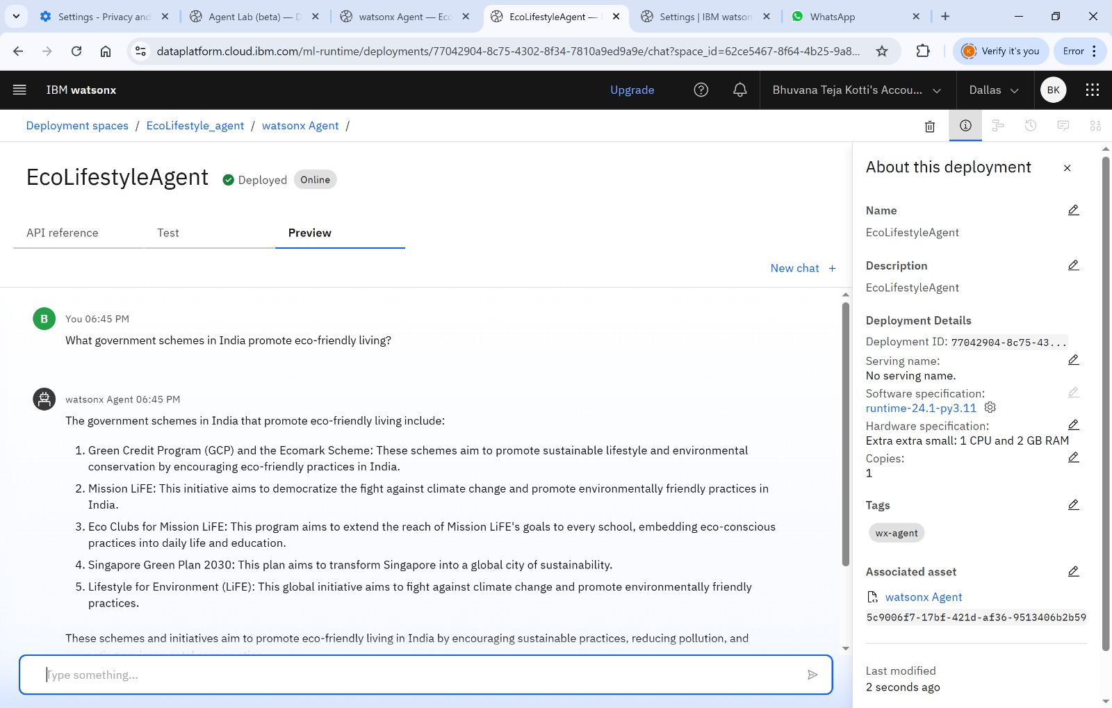
Result

Slide 12
Conclusion
The Eco Lifestyle Agent is a smart AI assistant built using IBM watsonx.ai to promote sustainable and eco-friendly living. Without relying on Granite models, it effectively utilizes open-source models and Retrieval-Augmented Generation (RAG) to provide reliable, real-time answers from trusted sources.
This project proves that impactful AI solutions can be built using lightweight, cost-effective tools on the IBM Cloud Lite platform. By guiding users with personalized suggestions, the agent supports everyday green choices, encouraging an environmentally conscious lifestyle.
It highlights how AI can be leveraged responsibly to drive positive change — even without advanced paid models.

Slide 13
Future scope
🌍 Location-Based Personalization
Integrate real-time location data to provide city-specific recycling rules, local eco-events, and nearby green stores.
📱 Mobile App Integration
Develop a cross-platform app using React Native or Flutter to make the agent accessible on the go.
🔊 Voice Interaction Support
Enable voice-based queries using speech-to-text APIs for improved accessibility and user engagement.
📈 Analytics Dashboard
Add a dashboard to track user queries and behavior trends to improve future responses and content.
🔗 API & Sensor Integration
Connect with IoT devices (like smart meters) to give users feedback on energy or water usage patterns.
🧠 Model Upgrade
Migrate to advanced foundation models (like IBM Granite) when available on higher tiers for deeper contextual understanding.

Slide 14
References
1. IBM Watsonx.ai Agent Lab
https://www.ibm.com/products/watsonx/ai
(Used to build and deploy the AI agent)
2. IBM Cloud Lite
https://cloud.ibm.com
(Cloud platform for free-tier AI development)
3. UN Environment Programme (UNEP)
https://www.unep.org
(Eco tips, sustainability guidelines)
4. Ministry of Environment, Forest and Climate Change (India)
https://moef.gov.in
(Government schemes and sustainability programs)
5. Wikipedia – Sustainable Living
https://en.wikipedia.org/wiki/Sustainable_living
(General background and definitions)
6.. Google Search Tool in Watsonx
(Used as a fallback search tool for real-time answers)

Slide 15
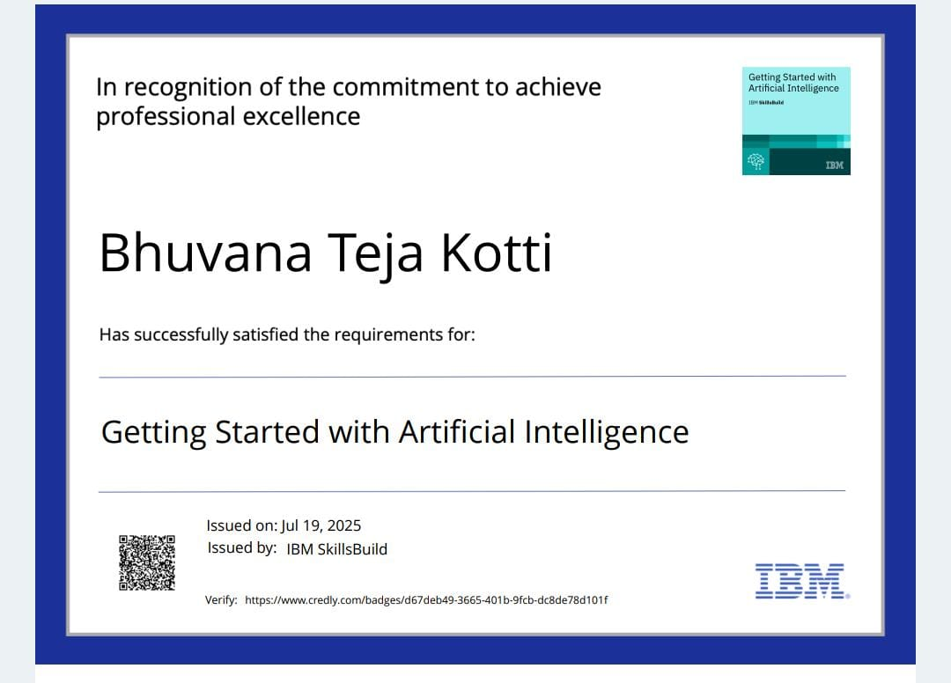
IBM Certifications
Screenshot/ credly certificate( getting started with AI)

Slide 16
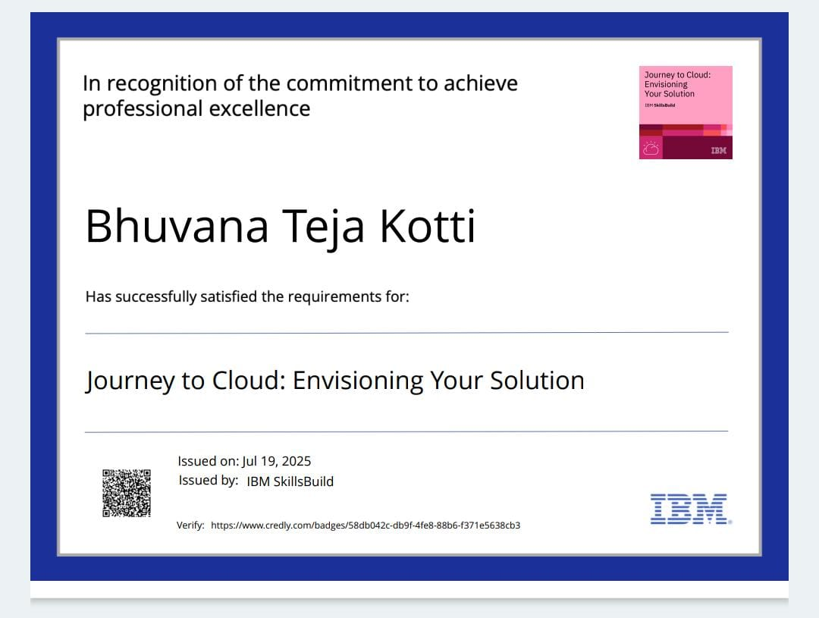
IBM Certifications
Screenshot/ credly certificate( Journey to Cloud)

Slide 17
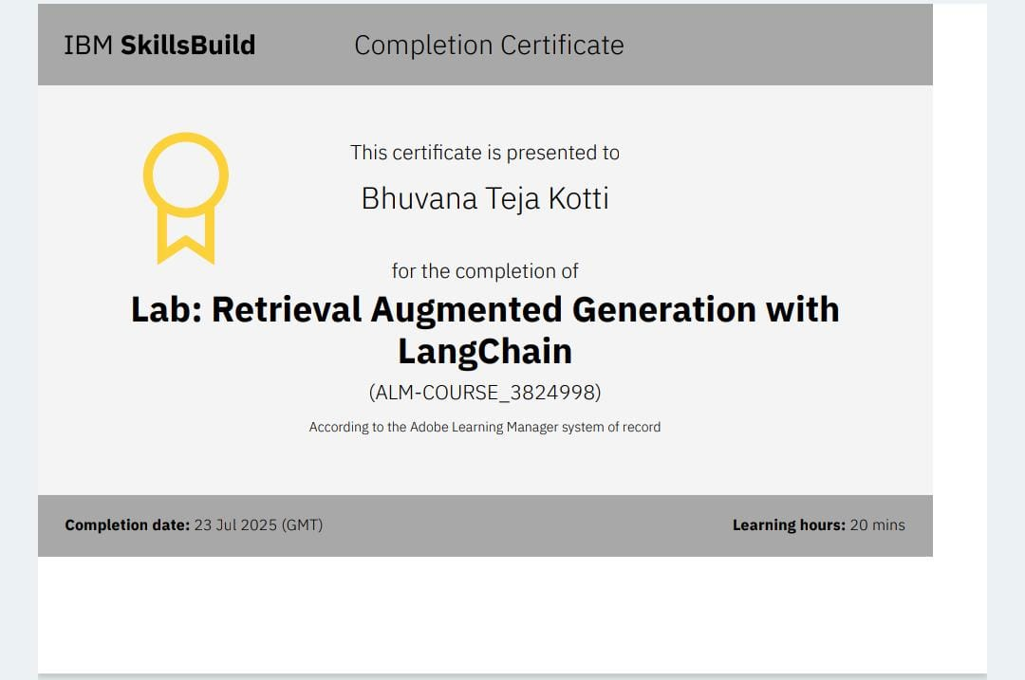
IBM Certifications
Screenshot/ credly certificate( RAG Lab)

Slide 18
Github link
https://github.com/Bhuvana16teja/IBMCloud-project

Slide 19
THANK YOU

